Slide 1

Telegram
Covert Channel
Bart Hofman , Paolo Scattolin, Martijn Peijer & Beau Mahler
Group: 20

Slide 2
Table of contents
Introduction
Steganography
Telegram Bot
Demo
Evaluation
Questions

Slide 3
Introduction - Covert Channels
A covert channel is a communication channel that can be exploited by a process to transfer information using non-standard methods.
Mostly against system design.
Storage Channels, our choice.
Timing Channels.
Notes:
In a covert timing channel a process will relay information by modulating the use of system resources based on different timing.
With a covert storage channel, a process writes data to a storage location where a process of a lower clearance level is able to read it.

Slide 4

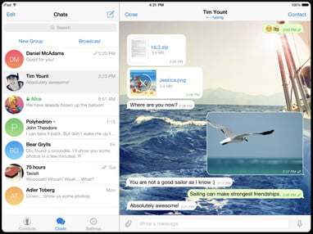
Introduction - The Project
Python
Encode/Decode images with Steganography
Communicate with a bot using Telegram
Windows/Linux/OSX based

Slide 5
Steganography
Encoding
Decoding
Key based
Uncompressed
Values of the message hidden pixels

Slide 6
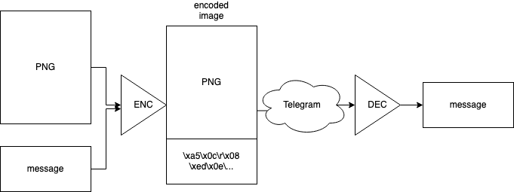
Schema

Slide 7
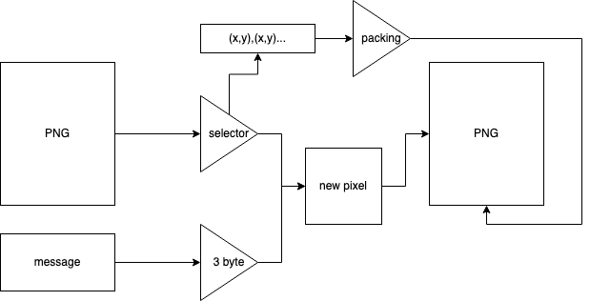
Encoder

Slide 8
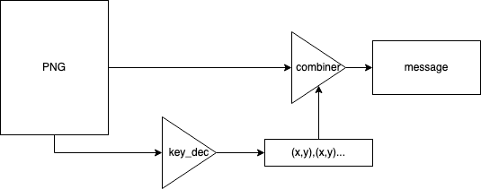
Decoder

Slide 9


This is a secret message, please do not share it with anyone

Slide 10

500 000 random characters

Slide 11


Telegram Bot
Covert channel
Telegram
Setting up bot(s) - @Botfather
Token
Communication

Slide 12
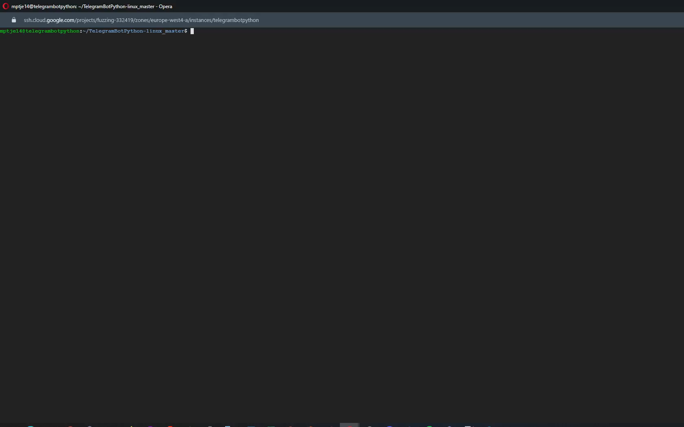

Slide 13
Evaluation
Pros:
Quite safe
Easy to use
Cost-free
Can choose own images and messages
Cons:
Not hard to detect*
Only works on uncompressed images and formats (ex. png)

Slide 14

Questions

